Slide 1


ENGR 1111 Intro to Engineering: Civil Engineering Fall 2022 Part 5: Environmental Engineering Case Studies

Slide 2
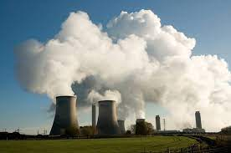

Part 5: Environmental Engineering Case Studies
Environmental Disasters
Anthropogenic
Environmental pollution and pollutants originating in human activity
Naturally Occurring Disasters

Slide 3
Part 5: Environmental Engineering Case Studies
Environmental Disasters
Anthropogenic
Environmental pollution and pollutants originating in human activity
Naturally Occurring Disasters

Slide 4
Part 5: Environmental Engineering Case Studies
Environmental Disasters
Anthropogenic
Bhopal: the Union Carbide gas leak
Chernobyl: Russian nuclear power plant explosion
Seveso: Italian dioxin crisis
1952 London smog disaster
Major oil spills
Love Canal chemical waste dump
Baia Mare cyanide spill
European BSE crisis
Spanish waste water spill
Three Mile Island near nuclear disaster

Slide 5
Part 5: Environmental Engineering Case Studies
1. Bhopal: the Union Carbide gas leak
December 3, 1984
Bhopal, India
A poisonous gas cloud escaped from the Union Carbide India Limited (UCIL) pesticide factory
The cloud contained 15 metric tons of methyl isocyanate (MIC), covering an area of more than 50 square kilometers

Slide 6
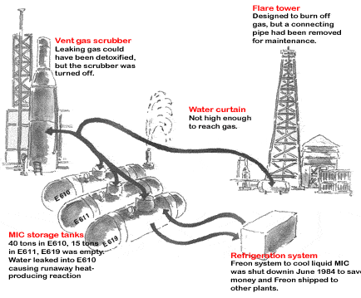
Part 5: Environmental Engineering Case Studies
Water entered MIC storage tanks
Exothermal reaction large enough to open safety valves
Scrubbers were turned off

Slide 7
Part 5: Environmental Engineering Case Studies
Neglect:
No valves present to prevent water from entering storage tanks
Cooling installation and flaring installation that might have flared the gas were out of order
Safety was low compared to other locations due to budget cuts

Slide 8
Part 5: Environmental Engineering Case Studies
Effects:
Killed at least 4,000 local residents instantly
Caused health problems for at least 50,000 people
More than 15,000 people died in the years that followed
More than 100,000 people still suffer chronic disease

Slide 9
Part 5: Environmental Engineering Case Studies
2. Chernobyl: Russian nuclear power plant explosion
April 26, 1986
Ukraine (129 km from Kiev)
Tests were conducted on nuclear reactor 4 of the Chernobyl nuclear power plant that resulted in the security system being turned off
Errors in design and personnel judgement caused cooling water to start boiling

Slide 10
Part 5: Environmental Engineering Case Studies
Energy production increased to 10 times the normal level and temperatures reached more than 2000 degrees Celsius, causing fuel rod melting and more cooling water boiling
Extreme pressures in cooling water pipes resulted in cracks, causing steam to escape
This steam caused an explosion, slamming off the roof of the building, starting a major fire and simultaneously forming an atmospheric cloud containing approximately 185 to 250 million curies of radioactive material

Slide 11
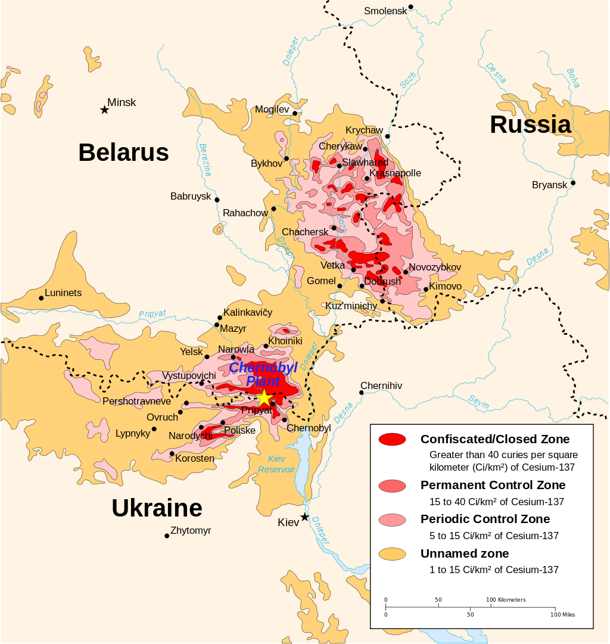
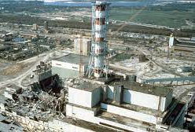
Part 5: Environmental Engineering Case Studies

Slide 12
Part 5: Environmental Engineering Case Studies
Effects:
Killed 31 people instantly
A zone of a 30 km radius was permanently evacuated
The radioactive cloud covered Europe and reached the Netherlands
The World Health Organization estimates that approximately 800,000 people have worked on restoring and cleaning after the accident

Slide 13
Part 5: Environmental Engineering Case Studies
Effects:
deaths have occurred from radiation and other health problems
Some sources place the death toll over 400,000 people
Hundreds of people were diagnosed with radiation sickness.
Increase in thyroid cancers, leukemia, birth defects, and genetic defects

Slide 14
Part 5: Environmental Engineering Case Studies
3. Seveso: Italian dioxin crisis
July 10, 1976
Meda, Italy
An explosion occurred in a 2,4,5-trichlorophenol (TCP) reactor at the ICMESA chemical company
A toxic cloud containing high concentrations of TCDD (a highly toxic form of dioxin) was released into the atmosphere

Slide 15
Part 5: Environmental Engineering Case Studies
Effects:
Heavily polluted soils
Led to the introduction of European regulation for the prevention and control of heavy accidents involving toxic substances – Seveso Directive

Slide 16
Part 5: Environmental Engineering Case Studies
4. 1952 London smog disaster
London, England
December 1952-March 1953
Light winds and a high moisture content created ideal conditions for smog formation. Unusual cold caused additional coal combustion and many people travelled only by car, which caused the occurrence of a combination of black soot, sticky particles of tar and gaseous sulphur dioxide.

Slide 17
Part 5: Environmental Engineering Case Studies
Concentration of particulate matter in the air had reached 56 times its normal level.
Sulphur dioxide concentrations increased to seven times its peak level.
Sulphur dioxide reacted with substances in foggy droplets to form sulphuric acid, adding an intense form of acid rain to the process. Read more: https://www.lenntech.com/environmental-disasters.htm#ixzz7g5dq7MO4

Slide 18
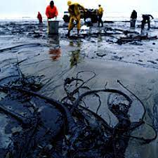
Part 5: Environmental Engineering Case Studies
Major oil spills
Amaco Cadiz
Piper Alpha
Exxon Valdez
Gulf War
Tricolor

Slide 19
Part 5: Environmental Engineering Case Studies
Other
- 1967 Liberian tanker Torrey Canyon spills 120,000 ton oil near Cornwall - 1968 Witwater tanker spills 14,000 barrels of oil near Panama coast - 1969 tanker Hamilton trader spills 4,000 barrels of oil in Liverpool Bay, England - 1970 tanker Arrow spills 77,000 barrels of oil near Nova Scotia, Canada - 1971 tanker Wafra spills 20,000 barrels of oil near Cape Agulhas, Africa - 1972 tanker Sea Star catches fire after collision in Gulf of Mexico waste dump

Slide 20
Part 5: Environmental Engineering Case Studies
Other
- 1974 Dutch tanker Metulla spills 53.,000 ton crude oil near South Chile - 1976 Liberian tanker Argo Merchant spilled 29,000 square meters of oil near the Massachusetts coast - 1976 Spanish tanker Urquillo spills more than 100,000 ton oil near Spain - 1977 tanker Al Rawdatain spills 7,350 barrels of oil near Genoa, Italy - 1977 tanker Borug spills 213,692 barrels of oil near the coast of Taiwan - 1978 Brazilian Marina spills 73,600 barrels of oil near Sao Sebastiao, Brazil

Slide 21
Part 5: Environmental Engineering Case Studies
Other
- 1979 Betegeuse spills 14,720 barrels of oil near Bantry Bay, Ireland - 1979 Ixtoc I exploratory well in Mexico blows out and spills 600,000 tons of oil - 1984 Alvenus tanker grounds southeast of Cameron, Louisiana and spills 65,000 barrels of oil - 1985 ARCO Anchorage spills 5,690 barrels of oil near the coast of Washington State, US - 1986 unknown oil spill reaches the coast of Georgia (US) and is later appointed to the Amazon Vulture tanker - 1989 Aragon tanker spills 175,000 barrels of oil near Madeira, Portugal

Slide 22
Part 5: Environmental Engineering Case Studies
Other
- 1990 tanker American Trader grounds near Huntington Beach, California and spills 9,458 barrels of oil - 1990 Cibro Savannah tanker catches fire and spills 481 square meters of oil - 1990 Jupiter tanker catches fire in Bay City, Mexico and causes oil spill - 1990 Mega Borg tanker catches fire and spills 19,000 square meters of oil near Galveston, Texas - 1991 tanker Bahia Paraiso spills 3,774 barrels of oil near Palmer Station, Antarctica - 1992 Greek tanker Aegean Sea spills 70,000 ton oil near Galicia

Slide 23
Part 5: Environmental Engineering Case Studies
Other
- 1993 Bouchard B155 tanker spills 1,270 square meters of fuel oil after collision with 2 ships - 1996 Liberian tanker Sea Empress spills 147,000 ton oil near Wales - 1999 Maltese tanker Erika spills 30,000 ton oil near Brittany - 2001 tanker Jessica spills 900 ton oil near the Galapagos Isles - 2002 Bahamese Prestige spills oil near Galicia Read more: https://www.lenntech.com/environmental-disasters.htm#

Slide 24
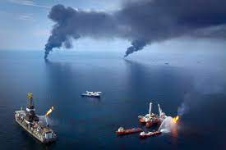
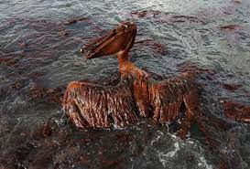
Part 5: Environmental Engineering Case Studies
Source
https://www.lenntech.com/environmental-disasters.htm

Slide 25
ENGR 1111 Intro to Engineering: Civil Engineering Fall 2022 Part 5: Environmental Engineering Case Studies

